Slide 1


SQL Project
ENERGY DRINK
MARKET ANALYSIS
-VANSHITA MATHUR

Slide 2

OBJECTIVE
The objective of this project is to analyze the survey results to generate actionable insights that provide the Marketing Team with valuable recommendations for optimizing their marketing strategies, enhancing product offerings, and improving customer engagement.
The analysis is done using SQL.

Slide 3

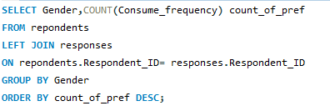
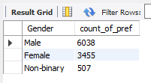
Who prefers energy drink more?
(male/female/non-binary)?
Solution:
Result:

Slide 4

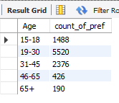
Which age group prefers energy drinks more?
Solution:
Result:

Slide 5
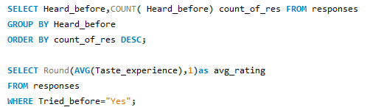


What do people think about our brand?
Solution:
Result:

Slide 6
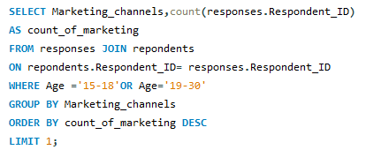


Which type of marketing reaches the most Youth
Solution:
Result:

Slide 7

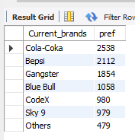

Who are the current market leaders?
Solution:
Result:

Slide 8
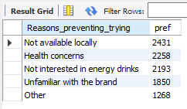
Which area of business should we focus more on our product development? (Branding/taste/availability)
Solution:
Result:

Slide 9
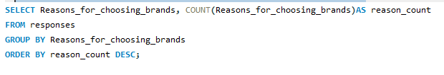
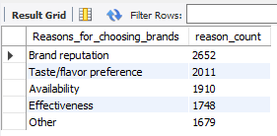
What are the primary reasons consumers prefer those brands over ours?
Solution:
Result:

Slide 10
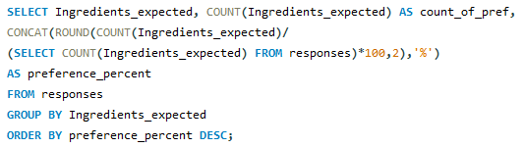
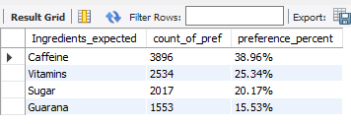
What are the preferred ingredients of energy drinks among respondents?
Solution:
Result:

Slide 11
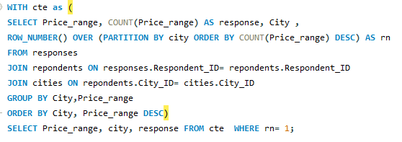
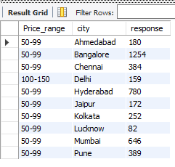
What Should be the price range of drink according to city?
Solution:
Result:

Slide 12
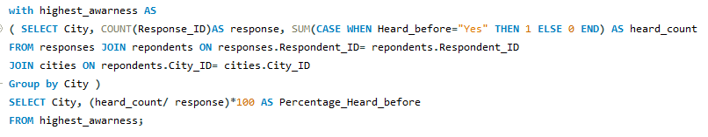
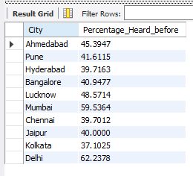
Which cities have the highest percentage of respondents who have heard of the brand before?
Solution:
Result:

Slide 13

CONCLUSION
Prioritize marketing campaigns aimed at the male demographic.
Develop age-specific marketing strategies, particularly focusing on the 19-30 age group.
Increase investment in effective marketing channels, such as social media platforms, influencer partnerships, and digital advertising.
Consider reformulating the product to emphasize preferred ingredients like caffeine.

Slide 14
Amplify marketing efforts in cities with low brand awareness, including Chennai, Kolkata, and Hyderabad.
Implement a pricing strategy tailored to specific cities.
Analyze the successful strategies of leading brands like Coca-Cola and Pepsi to identify key success factors.
Enhance the availability of the product to ensure wider reach and accessibility.

Slide 15




THANK
YOU

